Slide 1
Title
Date

Slide 2
Title
Text

Slide 3
Title
Text
Text
Text

Slide 4
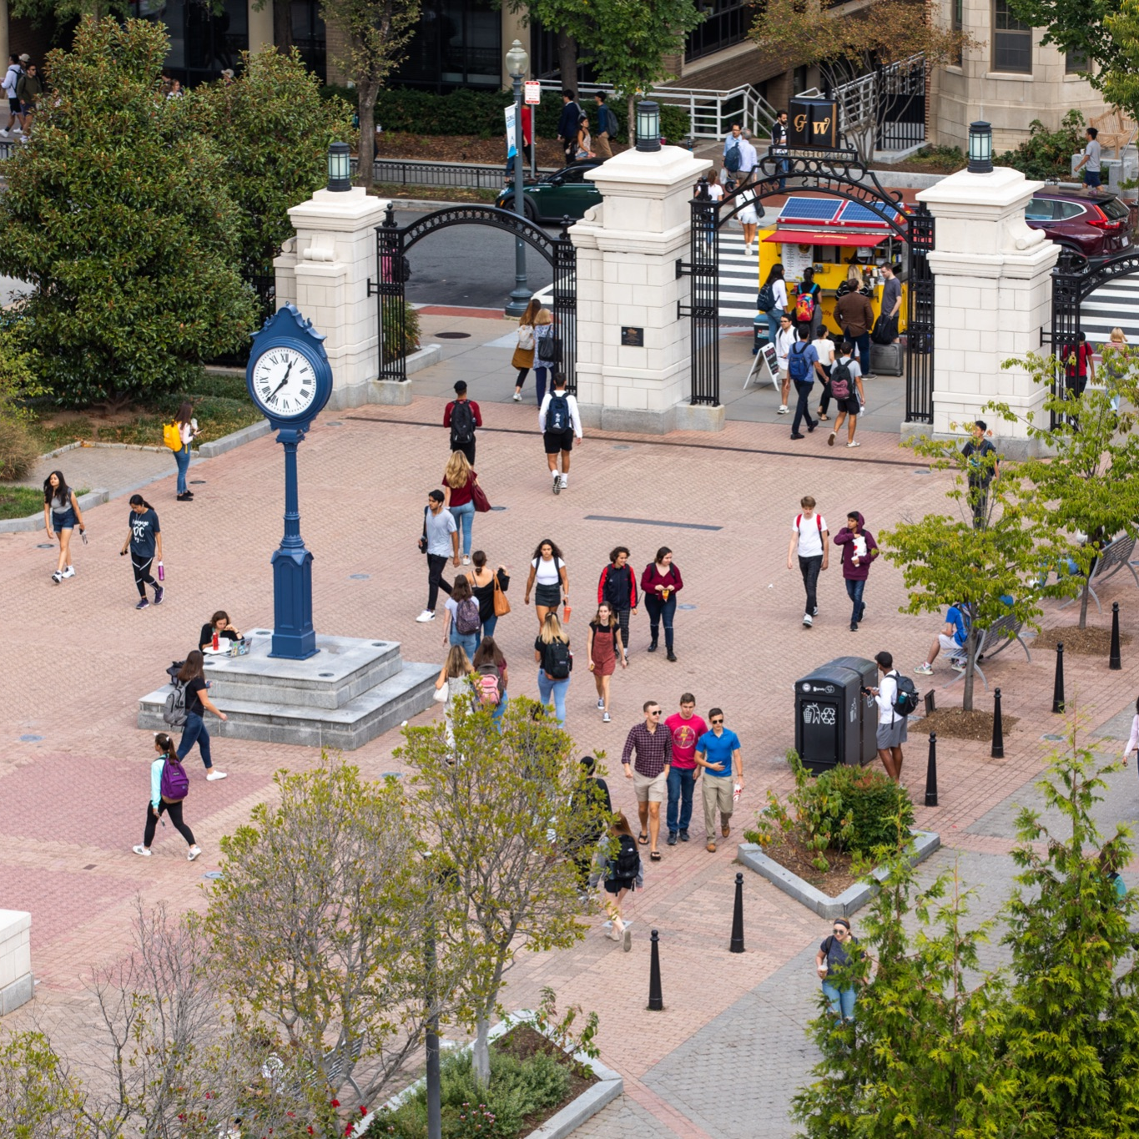
Thank you.

